Slide 1
Machine Learning and Modeling TechniqueS – KNN (PART 1)
Cuny LaGUardia community college

Slide 2

What is knn?
KNN – K-Nearest Neighbors
KNN can be used for both classification and regression predictive problems. However, it is more widely used in classification problems in the industry.

Slide 3
What is knn?
Nearest neighbors is one of the simplest predictive models there is. It makes no mathematical assumptions, and it doesn’t require any sort of heavy machinery. The only things it requires are:
Some notion of distance
An assumption that points that are close to one another are similar

Slide 4
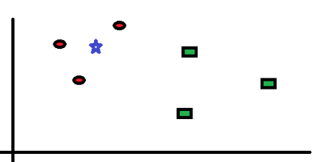
K-nearest neighbors (Knn) analyticsvidhya.com
The following shows a various points on a graph – red circles and green squares .
We want to find the class of the blue star – it can either be a red circle or a green square.

Slide 5
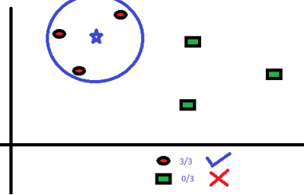
K-nearest neighbors (Knn) analyticsvidhya.com
The ‘K’ in KNN is the nearest neighbors we want to look at. For example, if K = 3
The 3 closest points to the blue star are red circles. We can confidently say that the blue star should be a red circle.

Slide 6
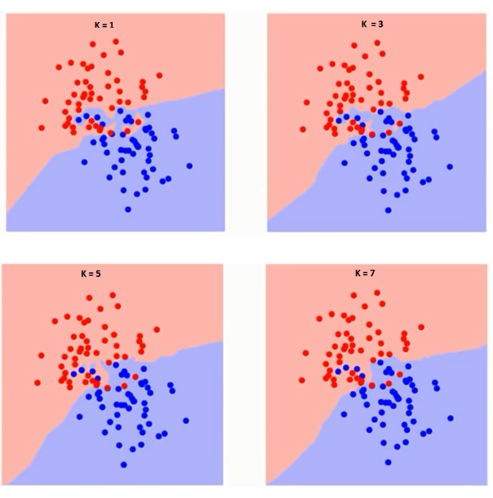
How is the ‘k’ choosen?
If you look closely, you can see how the boundary lines become smoother as K is increased.
Eventually, K increasing to infinity, the boundary would encompass the entire blue or red.

Slide 7
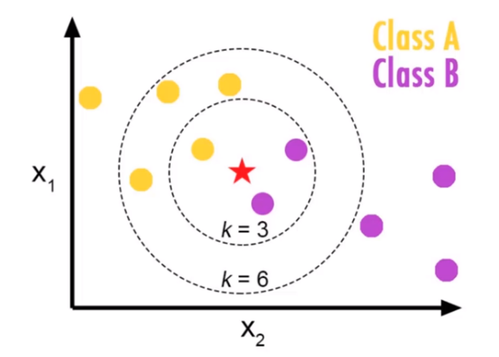
KNN

Slide 8
KNN
“The algorithm finds the most similar observations to the one you have to predict and from which you derive a good intuition of the possible answer by averaging the neighboring values, or by picking the most frequent answer class among them.”
https://www.youtube.com/watch?v=UqYde-LULfs 0:00-1:45

Slide 9
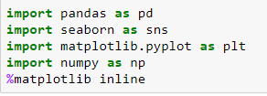
KNN
Lets start by loading in necessary libraries

Slide 10
KNN
Load in our data from the github account.
Visit the github, click on ‘classified data’, click ‘View Raw’ then copy the link

Slide 11
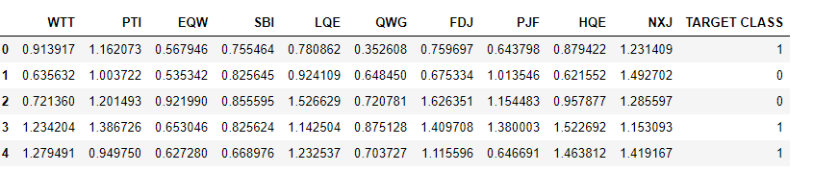
KNN
View the head of our dataset.
Notice the ‘TARGET CLASS’ variable.

Slide 12
KNN
Because the KNN classifier predicts the class of a given test observation by identifying the observations that are nearest to it, the scale of the variables matters.
Any variables that are on a large scale will have a much larger effect on the distance between the observations, and also on the KNN model, than variables that are on a small scale.
In order to have an effective and accurate model, we need to standardize all of our values. This can be done easily with Python.

Slide 13
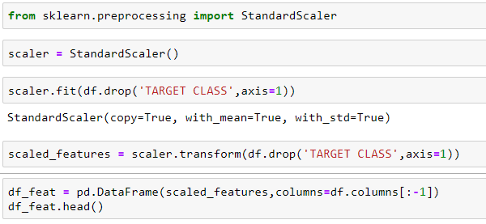
knn
Lets standardize our data and drop our TARGET CLASS variable

Slide 14
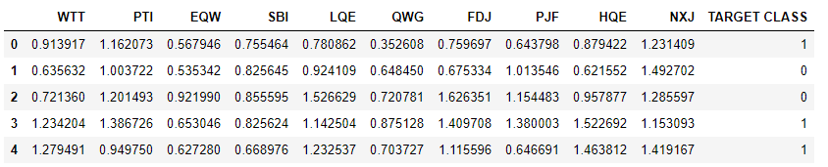
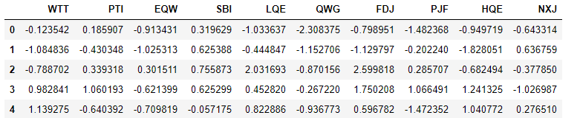
KNN
View the scaled data now – what do you notice?

Slide 15
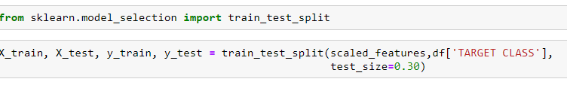
KNN
Similar to our previous models, we need to split our data into a train/test split. We can do this by using Python’s sklearn library.
This code is something that most don’t memorize – they call upon it when needed (from a saved file, online, etc.)
We are splitting our data at the .30 test size.

Slide 16
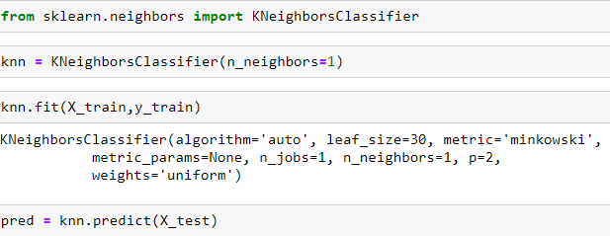
KNN
Lets use the KNN model now. Remember – we’re looking at TARGET CLASS (0,1) (or – yes/no, etc.)
Lets start with a K value of K = 1

Slide 17
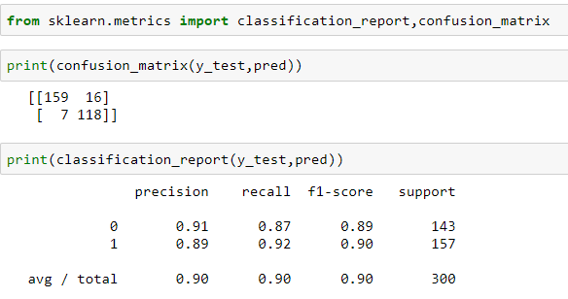
KNN
Now that we’ve created our model, lets evaluate how well it performs.
Recall from our previous lesson the confusion matrix
Not bad – lets see if we can improve it.

Slide 18
KNN
Change the n_neighbors= value to something else … try to see how it impacts your confusion matrix.
Search online for a way to determine the K Value and try to apply to your model.

Slide 19
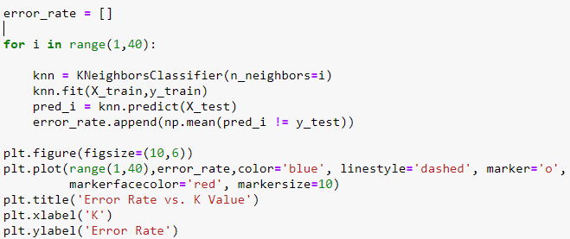
K- value

Slide 20
Break – 15 mins

Slide 21
KNN further practice
Visit the following article from datacamp:
https://www.datacamp.com/community/tutorials/k-nearest-neighbor-classification-scikit-learn
Read through the article and follow along with the Python examples.

